Slide 1
Searching and Ranking

Slide 2
History of Full-text Search Engines
1993, www.mit.edu went online as one of the first 100 web servers in the world
The grandfather of all search engines was Archie, created in 1990 by Alan Emtage, a student at McGill University in Montreal
Anonymous FTP: repositories for files
Gopher contains plain-text documents
Matthew Gray's World Wide Web Wanderer, the first robot on the web
  Initially, the Wanderer it counted only Web servers
  It started to capture URLs as it went along shortly after

Slide 3
History of Full-text Search Engines
Excite, Yahoo!, WebCrawler, Lycos, Infoseek
  They are all started before mid 1994
AltaVista
  1995~
  First to use natural language queries: "What is the weather like in Tokyo?“
  First to implement advanced searching techniques: AND, OR, NOT
  First search engine to allow users to add to and delete their own URLs from the index
  Search for all of the sites that link to a particular URL: find popularity!

Slide 4
History of Full-text Search Engines
HotBot, MetaCrawler
  1995~
Then you found Google
  1998~
Bing, Wolfram(knowledge engine)

Slide 5
Full-text Search Engine
Search a large set of documents
  For a list of words
Rank results
  According to how relevant the documents are to those words
Algorithms for full-text searches are among the most important collective intelligence algorithms
  Many fortunes have been made by new ideas in this field
This is a cross fields problem: information retrieval, machine learning, database technologies

Slide 6
Full-text Search
Retrieving every document with a given set of words is fairly straightforward once you have an index
But the real magic is in how the results are sorted

Slide 7
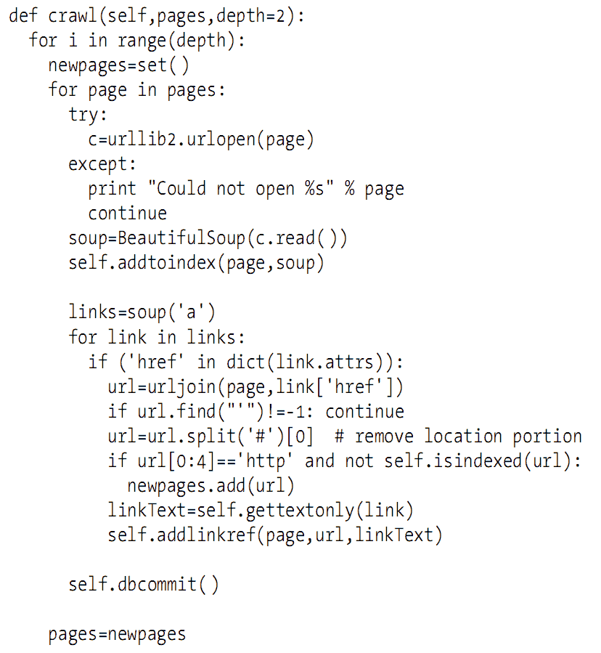
Simple
Crawler
Python with BeautifulSoup API

Slide 8
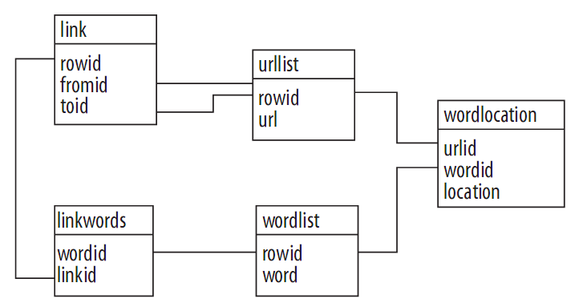

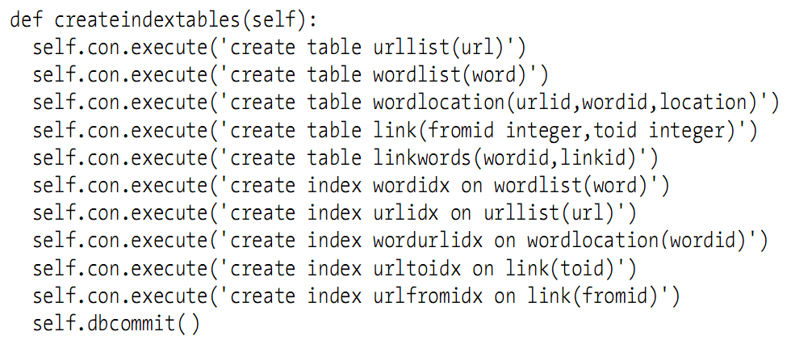
Building Index: DB Tables

Slide 9
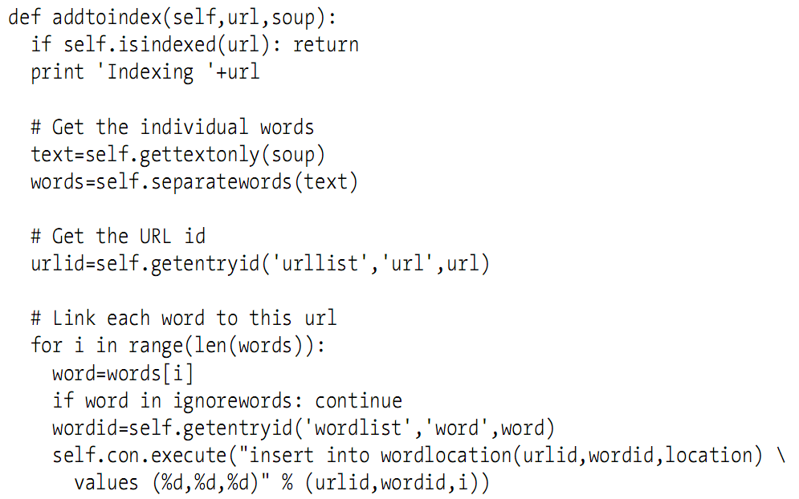
Building Index: Text to Tables
Get text first, then add into index tables
Ignore words: why?

Slide 10
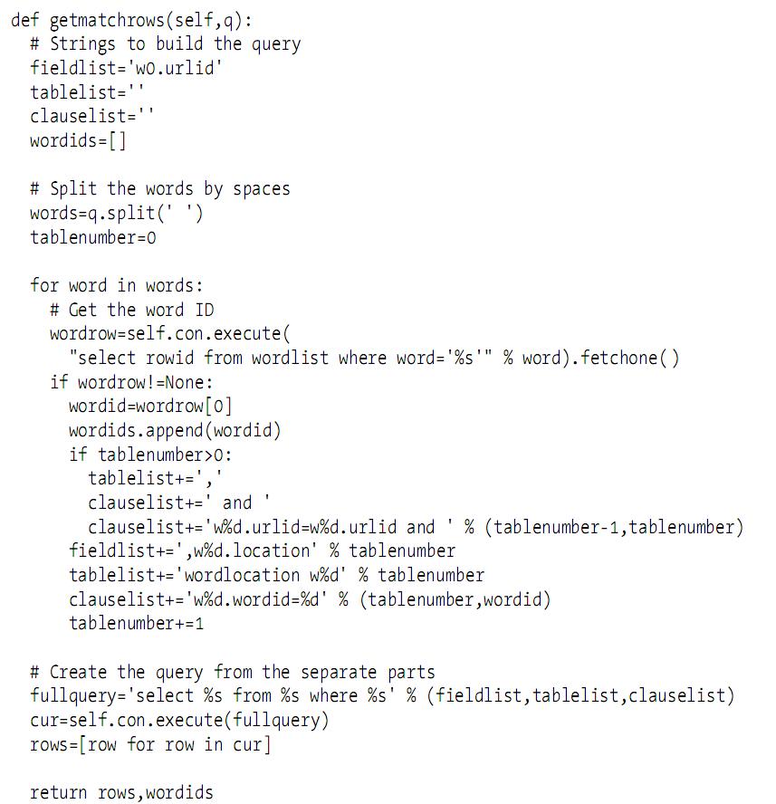
Querying

Slide 11
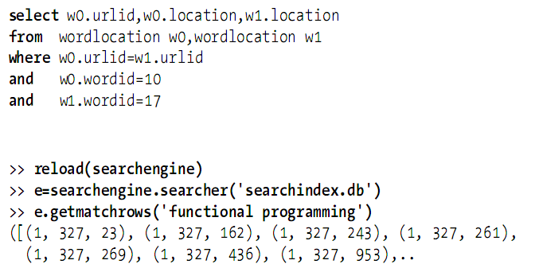
Sample Query Result

Slide 12
Recall the Full-text Search…
Retrieving every document with a given set of words is fairly straightforward once you have an index
But the real magic is in how the results are sorted
So, where is the REAL MAGIC?

Slide 13
Content-Based Ranking
Every document you retrieve should have a score
Score for content-based ranking, how?
  Word frequency
  Document location
  Word distance

Slide 14
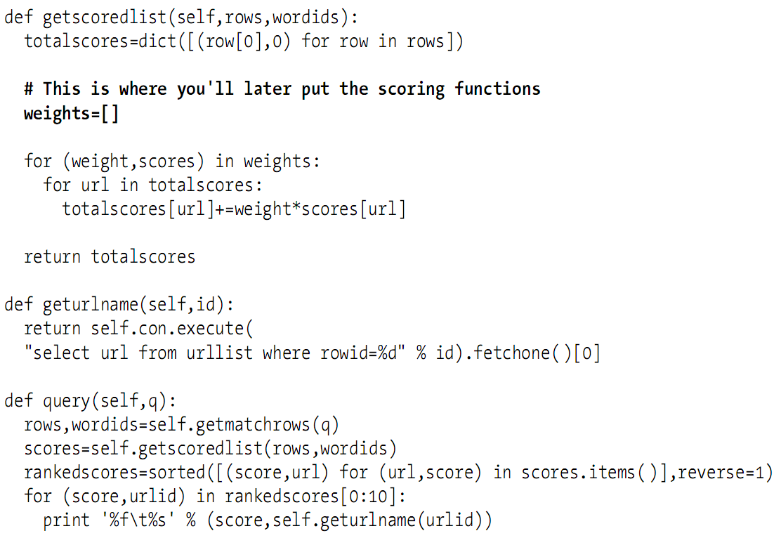
Scoring Flow
from: http://en.wikipedia.org/wiki/Correlation

Slide 15
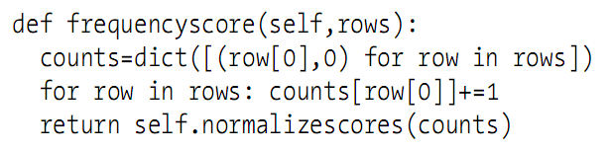
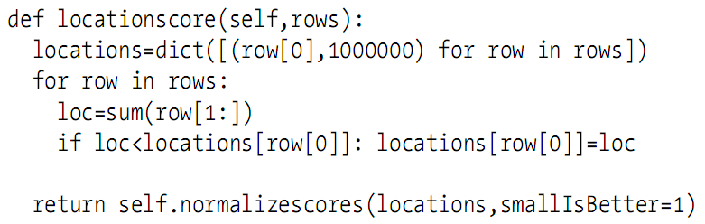
Scoring

Slide 16
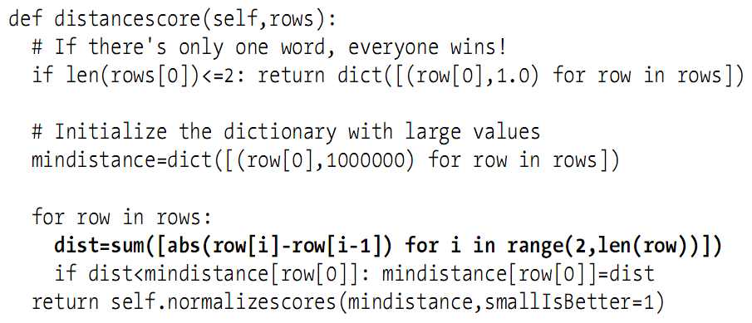
Scoring

Slide 17
Discussion: Problems of
Content-Based Ranking
Content-based ranking are calculated based on the weighted average of:
  Word frequency
  Document location
  Word distance
Discuss the disadvantages
Note not all reviewers have seen all movies!

Slide 18
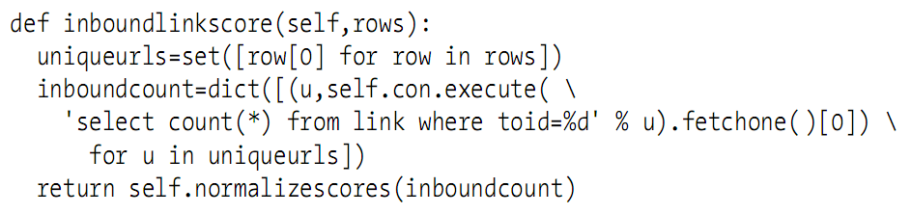
The Help: Inbound Links
Is ranking an expression of popularity?
  Who has linked to the page
  What they have said about it

Slide 19
The PageRank Algorithm
PageRank (by Larry Page)
  Calculates the probability that someone randomly clicking on links will arrive at a certain page
  The more inbound links the page has from other popular pages, the more likely it is that someone will end up there purely by chance
  There is an 85% that a user will continue clicking on links at each page: damping factor

Slide 20
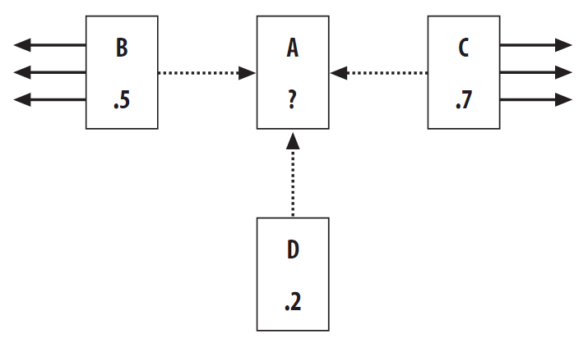
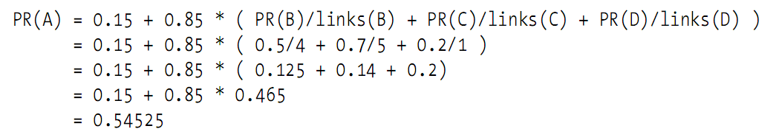
The PageRank Algorithm

Slide 21
Problem of PageRank
Chicken and egg debate!
Solution
  Set all the PageRanks to an initial arbitrary value
  Repeat the calculation over several iterations
  Will be stable

Slide 22
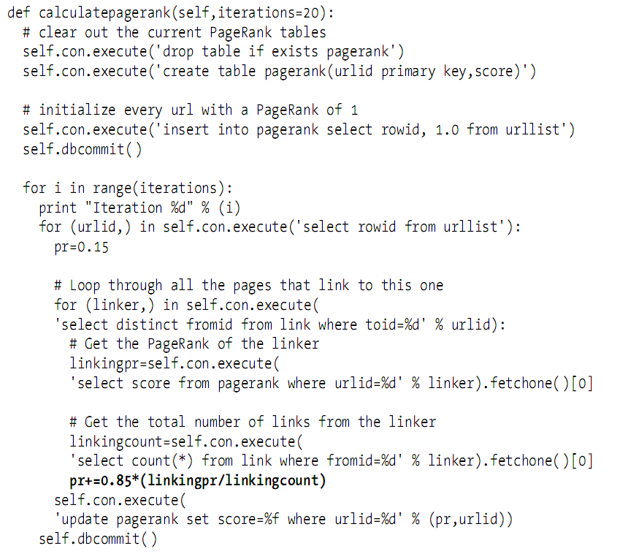
The Code

Slide 23
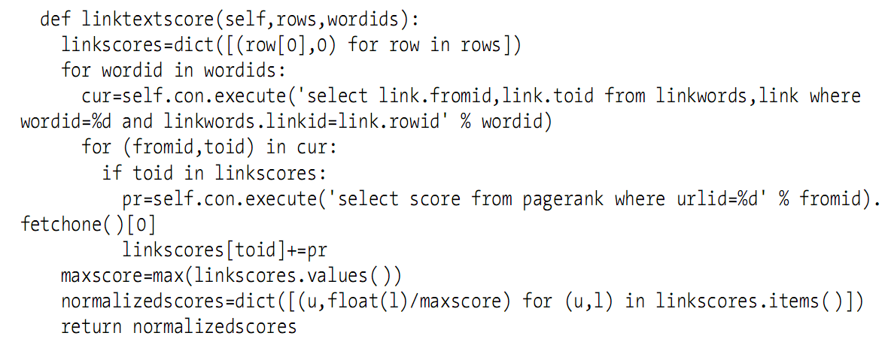
The Help: Using Link Text
A description of whatever it is they are linking to

